Slide 1




Data Types
Numeral Types and Type Conversion
Data
SoftUni Team
Technical Trainers
Software University
http://softuni.bg

Slide 2

Table of Contents
What is a Data Type?
Classical Data Types
Integer Types
Floating-Point Types
Type Conversion
void
sbyte
ushort
double
int
float
ulong
byte
uint
long
short

Slide 3
Questions?
sli.do #tech-softuni

Slide 4

Data Types, Variables and Type Conversions

Slide 5


How Computing Works?
Computers are machines that process data
Instructions and data are stored in the computer memory
10110

Slide 6
Variables
Variables have name, data type and value
Assignment is done by the operator "="
Example of variable definition and assignment in C#
When processed, data is stored back into variables
Variable name
Data type
int count = 5;
Variable value

Slide 7

What Is a Data Type?
A data type:
Is a domain of values of similar characteristics
Defines the type of information stored in the computer memory (in a variable)
Examples:
Positive integers: 1, 2, 3, …
Alphabetical characters: a, b, c, …
Days of week: Monday, Tuesday, …

Slide 8
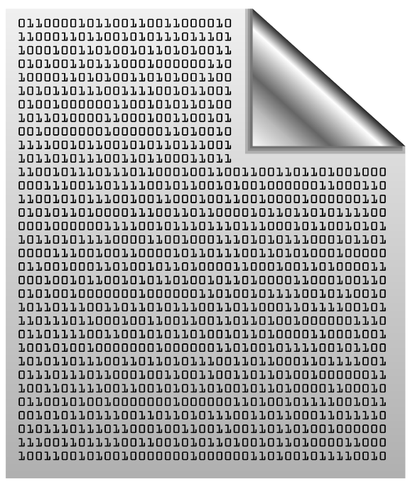

Data Type Characteristics
A data type has:
Name (C# keyword or .NET type)
Size (how much memory is used)
Default value
Example:
Integer numbers in C#
Name: int
Size: 32 bits (4 bytes)
Default value: 0
int: sequence of 32 bits in the memory
int: 4 sequential bytes in the memory

Slide 9
Integer Types
byte
sbyte
uint
short
int
ushort
long
ulong

Slide 10
Integer Types
sbyte [-128 …127]: signed 8-bit [-2⁷ … 2⁷-1]
byte [0 … 255]: unsigned 8-bit [0 … 2⁸-1]
short [-32 768 … 32 767]: signed 16-bit [-2¹⁵ … 2¹⁵-1]
ushort [0 … 65 535]: unsigned 16-bit [0 … 2¹⁶-1]
int [-2 147 483 648 … 2 147 483 647]: signed 32-bit [-2³¹ … 2³¹-1]
uint [0 … 4 294 967 295]: unsigned 32-bit [0 … 2³²-1]
long [-9 223 372 036 854 775 808 … 9 223 372 036 854 775 807]: signed 64-bit [-2⁶³ … 2⁶³-1]
ulong [0 … 18 446 744 073 709 551 615]: unsigned 64-bit [0 … 2⁶⁴-1]
byte
sbyte
uint
short
int
ushort
long
ulong

Slide 11
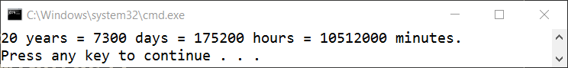
Time Since Birthday – Example
Depending on the unit of measure we can use different data types:
byte years = 20; // A small number (up to 255)
ushort days = 7300; // A small number (up to 32767)
uint hours = 175200; // A large number (up to 4.3 billions)
ulong minutes = 10512000; // A very big number (up to 18.4*10^18)
Console.WriteLine( "{0} years = {1} days = {2} hours = {3} minutes.", years, days, hours, minutes);

Slide 12
Beware of Integer Overflow!
Integers have range (minimal and maximal value)
Integers could overflow → this leads to incorrect values
byte counter = 0;
for (int i = 0; i < 260; i++)
{
counter++;
Console.WriteLine(counter);
}
1
2
…
255
0
1

Slide 13
Problem: Time Since Birthday
Write program to enter an integer number of years and convert it to days, hours and minutes
Years = 20
20 years = 7300 days = 175200 hours = 10512000 minutes.
Years = 14
14 years = 5110 days = 122640 hours = 7358400 minutes.
Check your solution here: https://judge.softuni.bg/Contests/Practice/Index/390#0

Slide 14
Solution: Time Since Birthday
Console.Write("Years - ");
byte years = byte.Parse(Console.ReadLine());
int days = years * 365;
int hours = days * 24;
int minutes = hours * 60;
Console.WriteLine("{0} years = {1} days = {2} hours = {3} minutes.", years, days, hours, minutes);
Check your solution here: https://judge.softuni.bg/Contests/Practice/Index/390#0

Slide 15
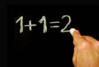
Integer Literals
int
sbyte
uint
long
byte
short
ulong
Examples of integer literals:
The '0x' and '0X' prefixes mean a hexadecimal value
E.g. 0xFE, 0xA8F1, 0xFFFFFFFF
The 'u' and 'U' suffixes mean a ulong or uint type
E.g. 12345678U, 0U
The 'l' and 'L' suffixes mean a long
E.g. 9876543L, 0L
ushort

Slide 16

Real Number Types
double
decimal
float
Floating-Point and Decimal Floating-Point Type

Slide 17

What are Floating-Point Types?
double
Floating-point types:
Represent real numbers, e.g. 1.25, -0.38
Have range and precision depending on the memory used
Sometimes behave abnormally in the calculations
May hold very small and very big values like 0.00000000000001 and 10000000000000000000000000000000000.0
float

Slide 18
Floating-Point Numbers
Floating-point types are:
float (±1.5 × 10⁻⁴⁵ to ±3.4 × 10³⁸)
32-bits, precision of 7 digits
double (±5.0 × 10⁻³²⁴ to ±1.7 × 10³⁰⁸)
64-bits, precision of 15-16 digits
The default value of floating-point types:
Is 0.0F for the float type
Is 0.0D for the double type
double
float

Slide 19
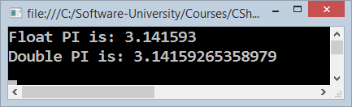
Pi Precision – Example
Difference in precision when using float and double:
NOTE: The "f" suffix in the first statement!
Real numbers are by default interpreted as double!
One should explicitly convert them to float
float floatPI = 3.141592653589793238f;
double doublePI = 3.141592653589793238;
Console.WriteLine("Float PI is: {0}", floatPI);
Console.WriteLine("Double PI is: {0}", doublePI);

Slide 20
Rounding Floating-Point Numbers
Math.Round(3.45) – round to integer number (mathematically)
Math.Round(2.3455, 3) – round with precision
Math.Ceiling() – round up to the nearest integer
Math.Floor() – round down to the nearest integer
Banker's rounding:
2.5 → 3
3.5 → 4
3.45 → 3
double a = 2.3455;
Console.WriteLine(Math.Round(a)); // result: 2
Console.WriteLine(Math.Round(a, 3)); // result: 2.346
Console.WriteLine(Math.Ceiling(a)); // result: 3
Console.WriteLine(Math.Floor(a)); // result: 2
Notes:
Goes to notes

Slide 21
Problem: Circle Perimeter (12 Digits Precision)
Write program to enter a radius r (real number) and print the perimeter of a circle with 12 digits after the decimal point:
Sample solution:
3.5
21.991148575129
1.2
7.539822368616
double r = double.Parse(Console.ReadLine());
Console.WriteLine("{0:f12}", 2 * Math.PI * r);
Check your solution here: https://judge.softuni.bg/Contests/Practice/Index/390#1

Slide 22
Scientific Notation
Floating-point numbers can use scientific notation, e.g.
1e+34, 1E34, 20e-3, 1e-12, -6.02e28
double d = 10000000000000000000000000000000000.0;
Console.WriteLine(d); // 1E+34
double d2 = 20e-3;
Console.WriteLine(d2); // 0.02
double d3 = double.MaxValue;
Console.WriteLine(d3); // 1.79769313486232E+308

Slide 23
Floating-Point Division
Integral division and floating-point division are different:
Console.WriteLine(10 / 4); // 2 (integral division)
Console.WriteLine(10 / 4.0); // 2.5 (real division)
Console.WriteLine(10 / 0.0); // Infinity
Console.WriteLine(-10 / 0.0); // -Infinity
Console.WriteLine(0 / 0.0); // NaN (not a number)
Console.WriteLine(8 % 2.5); // 0.5 (3 * 2.5 + 0.5 = 8)
int d = 0; // Integral division works differently
Console.WriteLine(10 / d); // DivideByZeroException

Slide 24

Floating-Point Calculations – Abnormalities
Sometimes floating-point numbers work incorrectly!
Console.WriteLine(100000000000000.0 + 0.3);
// Result: 100000000000000 (loss of precision)
double a = 1.0f, b = 0.33f, sum = 1.33;
Console.WriteLine("a+b={0} sum={1} equal={2}",
a+b, sum, (a+b == sum));
// a+b=1.33000001311302 sum=1.33 equal=False
double one = 0;
for (int i = 0; i < 10000; i++) one += 0.0001;
Console.WriteLine(one); // 0.999999999999906

Slide 25

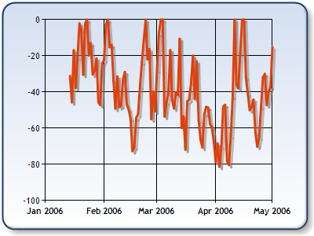
Decimal Floating-Point Type
There is a special decimal floating-point real number type in C#:
decimal (±1,0 × 10⁻²⁸ to ±7,9 × 10²⁸)
128-bits, precision of 28-29 digits
Used for financial calculations
Almost no round-off errors
Almost no loss of precision
The default value of decimal type is:
0.0M (M is the suffix for decimal numbers)
decimal
Notes:
Text goes to notes

Slide 26
Problem: Exact Product of Real Numbers
Write program to enter n numbers and print their exact sum:
2
78900000000000000000
6
473400000000000000000
2
0.00000000003
333333333333.3
9.999999999999
Check your solution here: https://judge.softuni.bg/Contests/Practice/Index/390#2

Slide 27
Solution: Exact Product of Real Numbers
This code works but makes mistakes sometimes:
Exchange double with decimal and check the differences
int n = int.Parse(Console.ReadLine());
double product = 0;
for (int i = 0; i < n; i++)
product *= double.Parse(Console.ReadLine());
Console.WriteLine(product);
Check your solution here: https://judge.softuni.bg/Contests/Practice/Index/390#2

Slide 28

Integer and Real Numbers
double
int
long
float
decimal
Live Exercises in Class (Lab)

Slide 29

Type Conversion

Slide 30
Type Conversion
Variables hold values of certain type
Type can be changed (converted) to another type
Implicit type conversion (lossless): variable of bigger type (e.g. double) takes smaller value (e.g. float)
Explicit type conversion (lossy) – when precision can be lost:
float heightInMeters = 1.74f;
double maxHeight = heightInMeters; // Implicit conversion
double size = 3.14;
int intSize = (int) size; // Explicit conversion → 3

Slide 31
Problem: Transport
Calculate how many courses will be needed to transport n persons by using 3 vehicles with capacity of 4, 8 and 12 respectively.
Sample solution:
2 courses
persons = 25
How? 25 people / (4 + 8 + 12) = 1.04 courses => 2 courses
int n = int.Parse(Console.ReadLine());
int courses = Math.Ceiling((double)n / (4 + 8 + 12));
Console.WriteLine(courses);
Check your solution here: https://judge.softuni.bg/Contests/Practice/Index/390#3

Slide 32

Summary
Classical data types:
Numeral types: Represent numbers
Have specific limits for every type
Variables – Store information
Have scope, span and lifetime

Slide 33








Data Types
https://softuni.bg/courses/programming-fundamentals/

Slide 34
License
This course (slides, examples, demos, videos, homework, etc.) is licensed under the "Creative Commons Attribution-NonCommercial-ShareAlike 4.0 International" license
Attribution: this work may contain portions from
"Fundamentals of Computer Programming with C#" book by Svetlin Nakov & Co. under CC-BY-SA license

Slide 35





Trainings @ Software University (SoftUni)
Software University – High-Quality Education, Profession and Job for Software Developers
softuni.bg
Software University Foundation
softuni.org
Software University @ Facebook
facebook.com/SoftwareUniversity
Software University Forums
forum.softuni.bg

